Slide 1

VMC
Promoting Active Life Medical Solution (PALMS)
Presented by Folashade Adewolu (Yinka)

Slide 2

Contents
What is a mental health disorder?
What is Post Traumatic Stress Disorder (PTSD)
Possible causes of PTSD?
What are the symptoms of PTSD?
Getting Help
What does help look like?
God’s plan for our health.
The Power of Your Mind
How to support people with PTSD?

Slide 3

Mental Health Disorder
A shift from the Order (Dis-Order)
Mental comes from the Late Latin term Mentalis (Mens) meaning “Mind”.
Mental illness is the presence of various conditions that impact mood, thinking, and behaviour, limiting people’s ability to function in daily life, irrespective of age, gender, or background.
NB: Mental health condition and mental health disorder are the same.

Slide 4
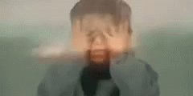
Post Traumatic Stress Disorder (PTSD)
What is PTSD? This is a mental health condition that can occur after experiencing or witnessing a traumatic event. Symptoms may include Flashbacks, Nightmares, Severe anxiety, and Uncontrollable thoughts about the events.

Slide 5
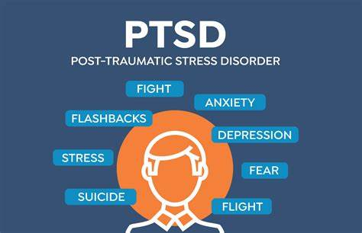
Symptoms
Possible causes of PTSD
Abuse: Physical or emotional.
Loss of a dear one / death.
Asylum seekers.
War: Ukraine, Israel, etc
Accident: e.g., car accident or fire.
Bullying: In Children, Young Adults, and Adults.
Stress: Chronic stress, lack of rest.
Traumatic childbirth: Caesarean Section.
It is important to be vigilant as parents to watch out for our children who might be experiencing anxiety due to bullying and abuse. Early Intervention is key.
For adults experiencing PTSD due to marital abuse, seek help quickly.

Slide 6
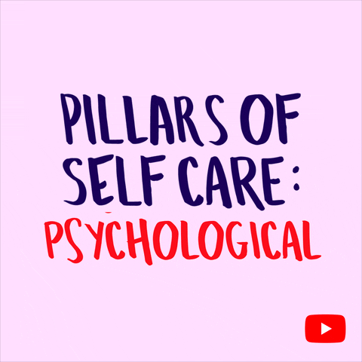
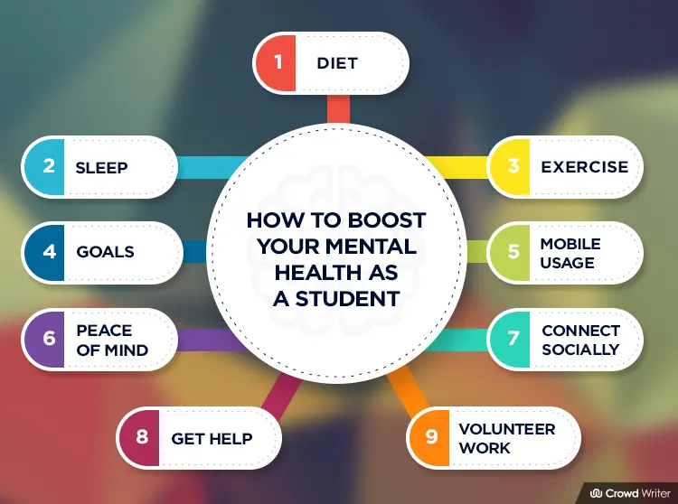
Getting Help: Self-Help; Children and Adults

Slide 7
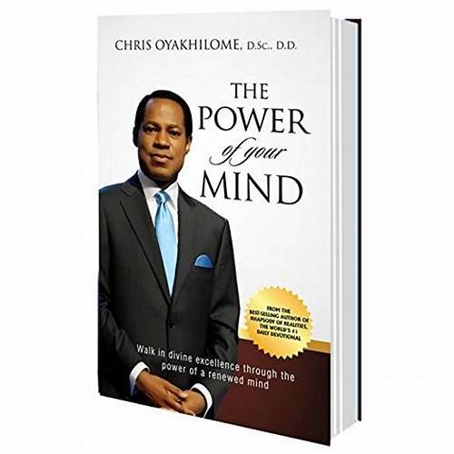
Getting Help: God’s plan for our health.
Beloved, I pray that in every way you may succeed and prosper and be in good health [physically], just as [I know] your soul prospers [spiritually].
3 John 1:2 AMP
The Power of Your Mind by Pastor Chris
Chapter 6 - Power of Thoughts: Pg. 67
Chapter 7 - Pulling down Strongholds: Pg. 83
Chapter 8 - Dealing with Negative Thoughts: 97
Chapter 10 – Your Mental Disposition: Pg. 117
Chapter 13 – See All Things New: Pg. 161
Get the book!

Slide 8
Power of Your Mind
“Don’t process, fabricate, or manufacture these negative feelings and emotions of worry, pain, anger, displeasure, grief, or hurt, because the joy of the LORD is your STRENGTH” pg. 98
- Renew your Mind (Eph. 4:23). Only let the best in you come forth.
- Take no thoughts (Philippians 4:6-7).
- See it First From Within, your future is History With God (Rm. 4:17).
- Your Set Time Is Here. Embrace the New Man (Col. 3:10).
NUGGETS
The mind is the faculty responsible for reasoning and thoughts. It possesses the power of imagination, recognition, and appreciation, and processes feelings and emotions, shaping attitude and behaviour.
The question is, what do you want to see?

Slide 9
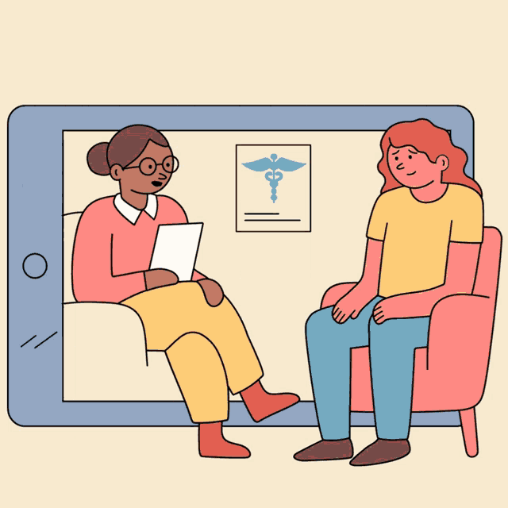
How to support people with PTSD?
Compassion: Approach discussions with kindness and understanding.
Active listening: Be fully present and attentive to what is being shared.
Biblical guidance: Offer wisdom from the word of God, referencing teachings such as The Power of the Mind.
Non-judgmental support: Foster a safe space for reflection and growth without condemnation.
Empathy over sympathy: Understand and share feelings without pity, focusing on encouragement and strength.
Confidentiality: Respect privacy by keeping sensitive conversations confidential, ensuring a safe and trusting environment.

Slide 10
Promoting Active Life Medical Solution (PALMS)
Projects
STAR Project for special needs children (Autism / Learning Disability). Your participation and contribution are welcome.
Physical Health Day. Sign up for BLS (CPR) training.
Do you need counselling or advice? meet the team.
Blood donation.
If you require more information, meet a member of the VMC at the end of the service.

Slide 11

